Slide 1
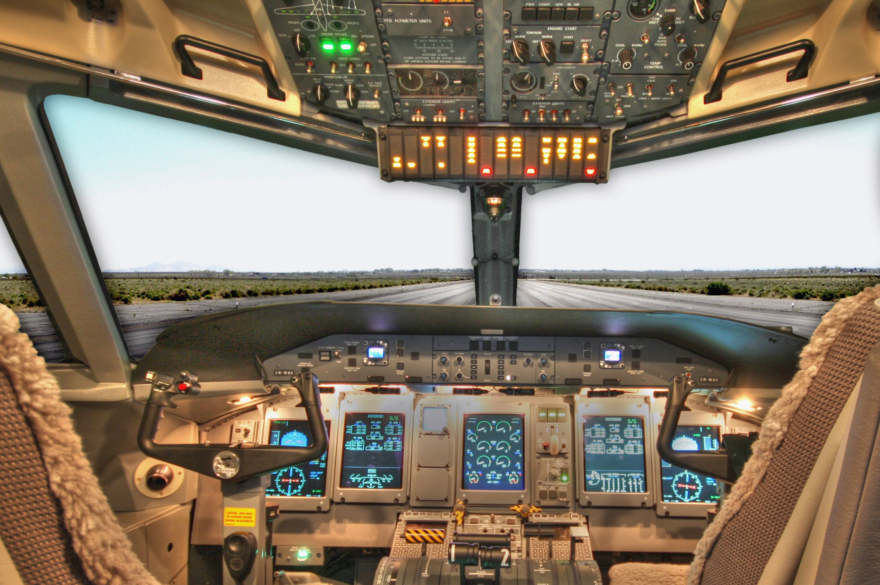
MAHESH BIYYALA UPASANA AJBANI VARNIKA GUMMI
Presented By,
ANAND KADIA
LIWANSHI RAHEJA

Slide 2
Requirements and Assumptions

Slide 3
Only Pilot shall be able to control the speed by pressing + or –.
Same sounds and different visuals shall be used for all alarms and it can be silenced only by Pilot.
Warnings are Visual only.
The software shall continue to work till landing time reaches 0.

Slide 4
The Plane shall initially be at 2000 ft with velocity of 350mph and time to land is 250 seconds.
We are assuming that the aircraft has air -resistance and slows down 1.4mph/second.
We are assuming that the aircraft loses its altitude at a rate of 8 ft/second.
The Gear Not Down alarm shall trigger if gear is not down when time < 120 sec.
The Gear Not Down alarm shall trigger if gear is not down when plane is < 1000 feet from ground.

Slide 5
The Gear Air speed alarm shall trigger if velocity > 300 mph.
we are assuming when the altitude < 1000 ft or time remaining for landing < 120 sec, Gear air speed alarm will trigger.
The gear speed alarm will only trigger when the speed is in between 300mph-400mph.

Slide 6
An automatic override shall be activated and raise the gear up to notify the visual warning to pilot and co-pilot, if landing gear is down and speed > 400mph.
We are assuming if the aircraft is travelling over 400mph at a height of less than 1000 ft. or the time is less than 120 sec or both then there will be NO automatic override but warning to reduce the speed.
We are assuming if the aircraft is travelling over 400mph at a height of greater than 1000 ft. and the time is greater than 120 sec then automatic override will prevent landing gear.

Slide 7
An automatic breaking shall be activated to notify Pilot with Air Brakes warning function and apply air break until v<250, if the plane is travelling at > 250 mph and 60 seconds.
We are assuming that the landing gear is down and altitude is less than 1000 ft.
We are assuming the speed can not be greater than 300mph.

Slide 8
User Interface

Slide 9
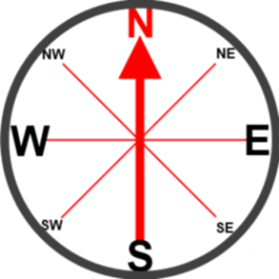

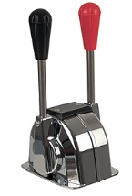

Display Senerio-1
ALT
1000
feet
Speed
401
mph
TIME
59
seconds
ALT
1000
feet
Speed
401
mph
TIME
59
seconds
-8
ft/s
-8
ft/s
Gear Up Command
Gear Up Command
Gear Not Down
Gear Not Down
Gear Air Speed
Gear Air Speed
Warning:
Air Break warning
Warning:
Air Break warning
Pilot Control Screen
Co-Pilot Control Screen
Aircraft
Speed
Gear position
Gear position
Up Down
Up Down

Slide 10
Display Senerio-2
ALT
1000
feet
Speed
401
mph
TIME
59
seconds
ALT
1000
feet
Speed
401
mph
TIME
59
seconds
-8
ft/s
-8
ft/s
Gear Up Command
Gear Up Command
Gear Not Down
Gear Not Down
Gear Air Speed
Gear Air Speed
Warning:
Air Break warning
Gear Override Warning
Warning:
Air Break warning
Gear Override Warning
Pilot Control Screen
Co-Pilot Control Screen
Aircraft
Speed
Gear position
Gear position
Up Down
Up Down

Slide 11
Display Senerio-3
ALT
999
feet
Speed
249
mph
TIME
121
seconds
ALT
999
feet
Speed
249
mph
TIME
121
seconds
-8
ft/s
-8
ft/s
Gear Up Command
Gear Up Command
Gear Not Down
Gear Not Down
Gear Air Speed
Gear Air Speed
Warning:
Warning:
Pilot Control Screen
Co-Pilot Control Screen
Aircraft
Speed
Gear position
Gear position
Up Down
Up Down

Slide 12
Display Senerio-4
ALT
1000
feet
Speed
401
mph
TIME
120
seconds
ALT
1000
feet
Speed
401
mph
TIME
120
seconds
-8
ft/s
-8
ft/s
Gear Up Command
Gear Up Command
Gear Not Down
Gear Not Down
Gear Air Speed
Gear Air Speed
Warning:
Gear Override Warning
Warning:
Gear Override Warning
Pilot Control Screen
Co-Pilot Control Screen
Aircraft
Speed
Gear position
Gear position
Up Down
Up Down

Slide 13
Display Senerio-5
ALT
1000
feet
Speed
400
mph
TIME
59
seconds
ALT
1000
feet
Speed
400
mph
TIME
59
seconds
-8
ft/s
-8
ft/s
Gear Up Command
Gear Up Command
Gear Not Down
Gear Not Down
Gear Air Speed
Gear Air Speed
Warning:
Air Break warning
Warning:
Air Break warning
Pilot Control Screen
Co-Pilot Control Screen
Aircraft
Speed
Gear position
Gear position
Up Down
Up Down

Slide 14
Display Senerio-6
ALT
1000
feet
Speed
400
mph
TIME
60
seconds
ALT
1000
feet
Speed
400
mph
TIME
60
seconds
-8
ft/s
-8
ft/s
Gear Up Command
Gear Up Command
Gear Not Down
Gear Not Down
Gear Air Speed
Gear Air Speed
Warning:
Warning:
Pilot Control Screen
Co-Pilot Control Screen
Aircraft
Speed
Gear position
Gear position
Up Down
Up Down

Slide 15
Display Senerio-7
ALT
1000
feet
Speed
300
mph
TIME
59
seconds
ALT
1000
feet
Speed
300
mph
TIME
59
seconds
-8
ft/s
-8
ft/s
Gear Up Command
Gear Up Command
Gear Not Down
Gear Not Down
Gear Air Speed
Gear Air Speed
Warning:
Air Break Warning
Warning:
Air Break Warning
Pilot Control Screen
Co-Pilot Control Screen
Aircraft
Speed
Gear position
Gear position
Up Down
Up Down

Slide 16
Display Senerio-8
ALT
1001
feet
Speed
249
mph
TIME
121
seconds
ALT
1001
feet
Speed
249
mph
TIME
121
seconds
-8
ft/s
-8
ft/s
Gear Up Command
Gear Up Command
Gear Not Down
Gear Not Down
Gear Air Speed
Gear Air Speed
Warning:
Warning:
Pilot Control Screen
Co-Pilot Control Screen
Gear position
Gear position
Aircraft
Speed
Up Down
Up Down

Slide 17
Decision Tables

Slide 18
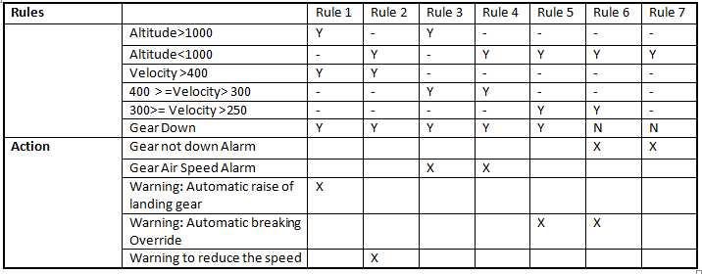
Altitude vs Velocity

Slide 19
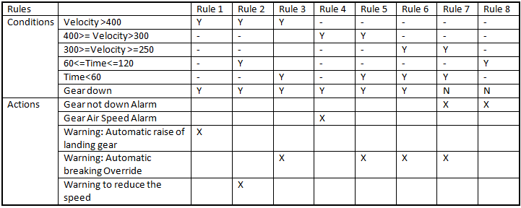
Velocity vs Time

Slide 20
State Diagram

Slide 21
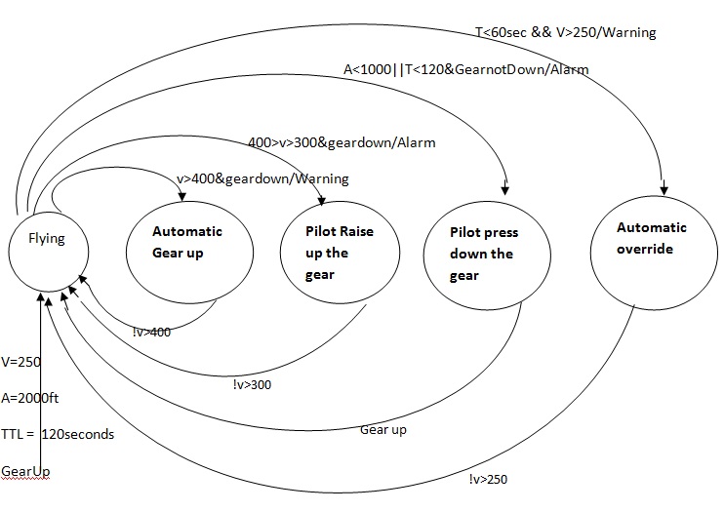

Slide 22
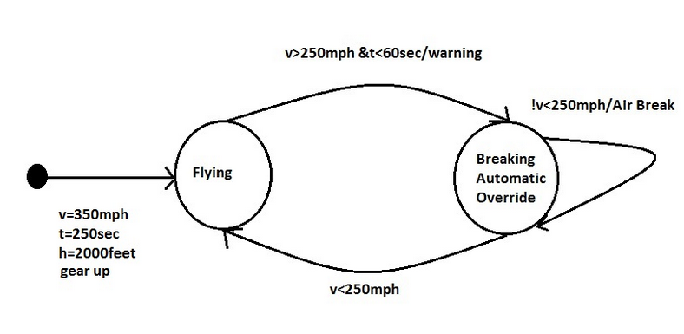

Slide 23
Thank You.

